Slide 1
Prediction based on the most efficient classification model

Slide 2
HELLO!
I am Kushagra Singh Chauhan
This is my presentation for the AIML training.
Roll No.1901640100152
kushagras634@gmail.com

Slide 3
Introduction
This is a project where we decide which feature extraction technique is best based on their NB classifier accuracies and after deciding the feature extraction technique, we select which classifier model(among NB classifier, Logistic Regression classifier, and SGD classifier) is best based on their accuracies and create a prediction algorithm based on the selected classifier model.

Slide 4
20 Newsgroups
1
Dataset

Slide 5
20 NEWSGROUPS DATASETS
The 20 Newsgroups data set is a collection of approximately 20,000 newsgroup documents, partitioned (nearly) evenly across 20 different newsgroups.
The 20 newsgroups collection has become a popular data set for experiments in text applications of machine learning techniques, such as text classification and text clustering

Slide 6
sklearn.datasets.fetch_20newsgroups
This is the predefined function from the skit-learn library.This function is used for loading the 20 newsgroups datasets.

Slide 7
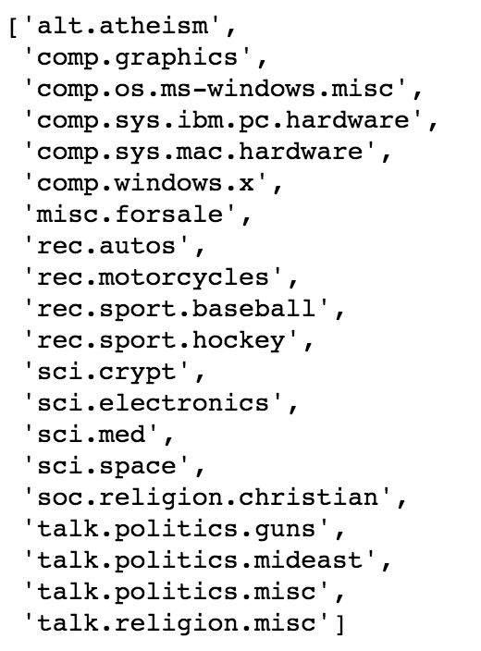
Dataset Files

Slide 8
Libraries required for this project
2
Prerequisites

Slide 9
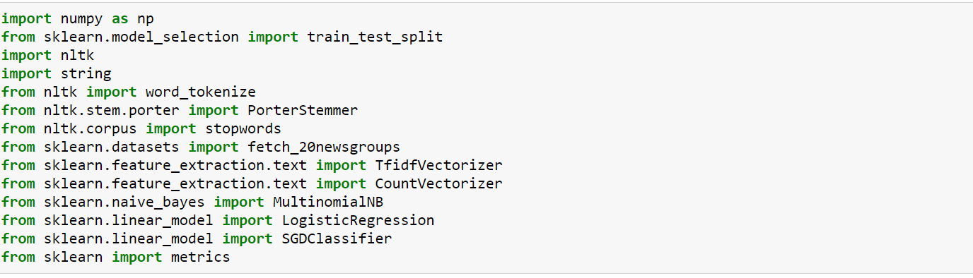
Libraries

Slide 10
Machine Learning Workflow
3
Definition

Slide 11
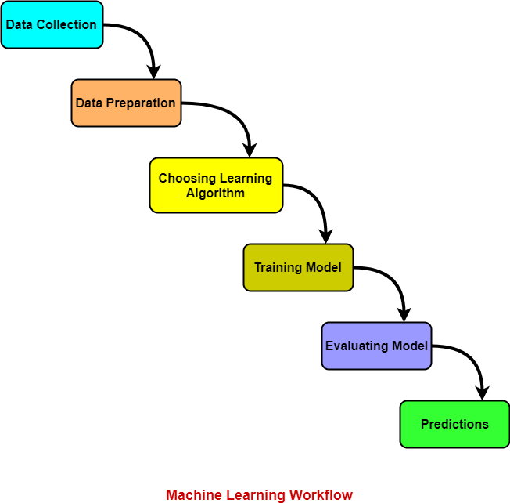
Machine learning techniques
Machine Learning Techniques can be divided into:
Data Collection
Data Wrangling(or Data Preparation)
Choosing Learning Algorithm
Training and testing a model
Optimizing and prediction

Slide 12
Data Collection
3.1
Step 1

Slide 13
Data Collection
Data collection can be defined as the procedure of collecting, measuring, and analyzing accurate insights for research using standard validated techniques.
In Machine Learning, we collect the data to apply various machine learning techniques based on their structure.

Slide 14
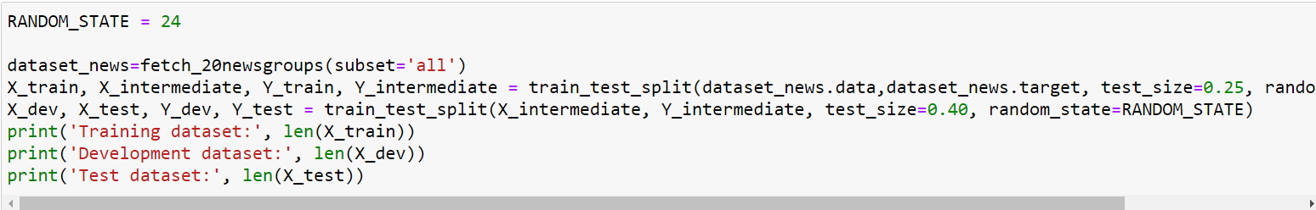
Data Collection for this project

Slide 15
Data Collection for this project
We are using the 20 newsgroups datasets and we are splitting this data sets into 3 parts:
Training data :We use training data to train a specific model by creating certain inputs(or outputs depending on the type of machine learning technique) for the machine learning technique. We use the training data to train this said machine.
Development data :Data used in development of the most efficient feature extraction algorithm.
Test data: Data used for testing of the classification model and checking which classification model has the best accuracy .
The entire dataset is split into the training set (75%), development set (15%), and test set (10%).

Slide 16
Data Wrangling Or Feature Extraction
3.2
Step 2

Slide 17
Data Wrangling
Data wrangling is the process of cleaning, structuring, and enriching raw data into the desired format for better decision-making in less time.
Data has become more diverse and unstructured, demanding increased time spent culling, cleaning, and organizing data ahead of broader analysis which has created a need for data cleaning.

Slide 18
Feature Extraction
The feature Extraction technique gives us new features that are a linear combination of the existing features. The new set of features will have different values as compared to the original feature values.
The main aim is to have fewer features that will are required to capture the same information. We might think that choosing fewer features might lead to underfitting, but in the case of the Feature Extraction technique, the extra data is generally noise.

Slide 19
CountVectorizer()
CountVectorizer is a great tool provided by the scikit-learn library in Python. It is used to transform a given text into a vector based on the frequency (count) of each word that occurs in the entire text. This is helpful when we have multiple such texts, and we wish to convert each word in each text into vectors (for use in further text analysis).
We will be using this function in feature extraction 1, feature extraction 2, and feature extraction 3

Slide 20
Feature Extraction 1
Feature Extraction 1 deals with un-preprocessed data, that contains stopwords, punctuation marks, missing data, noisy data, and some other type of irrelevant data.
Naive Bayes Classifier accuracy for this feature extraction is 0.8964.

Slide 21
Stopwords
A stop word is a commonly used word (such as “the”, “a”, “an”, “in”) that a search engine has been programmed to ignore, both when indexing entries for searching and when retrieving them as the result of a search query.
We would not want these words to take up space in our database, or taking up the valuable processing time. For this, we can remove them easily, by storing a list of words that you consider to stop words. NLTK(Natural Language Toolkit) in python has a list of stopwords stored in 16 different languages.
We are going to use stopwords that are in English as the dataset contains all text files which are in English

Slide 22
Tokenization
Tokenization is a way of separating a piece of text into smaller units called tokens. Here, tokens can be either word, characters, or subwords.
Hence, tokenization can be broadly classified into three types – word, character, and subword (n-gram characters) tokenization.
It’s a fundamental step in traditional NLP(Natural Processing Language) methods like Count Vectorizer and TfidfVectorizer.

Slide 23
Stemming
Stemming is one of the most common data pre-processing operations we do in almost all Natural Language Processing (NLP) projects.
Stemming is the process of removing a part of a word or reducing a word to its stem or root.In this project we are using Porter Stemmer.
The Porter stemming algorithm (or ‘Porter stemmer’) is a process for removing the commoner morphological and inflexional endings from words in English. Its main use is as part of a term normalization process that is usually done when setting up Information Retrieval systems.
Notes:
jhh

Slide 24
Function:Stem_token()
This function is created for the stemming of words.
This function takes text(string) as the argument and apply Porter stemmer to the text and returns a stemmed word.It is created for making stemmed tokens of a text data set.
Notes:
jhh

Slide 25
Function:Stem_stopword_tokenize()
As in this program, we are stemming first and then tokenizing it into words. This creates a problem, as stopwords are not stemmed and they cannot be removed at the time of data cleaning.
So we use this function for stemming stopwords so they can be removed at the time of data cleaning.
After stemming stopwords we can directly remove them from the tokenized dataset.
Notes:
jhh

Slide 26
Feature Extraction 2
In this feature extraction, we are preprocessing the data by applying certain preprocessing schemes such as:
Stemming
Tokenization
Removal of Stopwords
After preprocessing data we find its NB accuracy.
Naive Bayes Classifier accuracy for this feature extraction is 0.8939.
Notes:
jhh

Slide 27
Feature Extraction 3
In this feature extraction, we are preprocessing the data by applying certain preprocessing schemes such as:
Removal of Stopwords
Tokenization
Stemming
Removing accents
Converting text into lowercase
Performing other character normalization
Naive Bayes Classifier accuracy for this feature extraction is 0.9162.
Notes:
jhh

Slide 28
CountVectorizer() vs TfidfVectorizer()
CountVectorizer converts a collection of text documents to a matrix of token counts: the occurrences of tokens in each document. This implementation produces a sparse representation of the counts.
The TfidfVectorizer will tokenize documents, learn the vocabulary and inverse document frequency weightings, and allow you to encode new documents.
Notes:
jhh

Slide 29
Feature Extraction 4
In this feature extraction technique, we are using TfidfVectorizer instead of CountVectorizer.
We are preprocessing the data by applying certain preprocessing schemes such as:
Removal of Stopwords
Tokenization
Stemming
Removing accents
Performing other character normalization
Ignoring terms that are not within the constraints of the given thresholds
Naive Bayes Classifier accuracy for this feature extraction is 0.9197.
Notes:
jhh

Slide 30
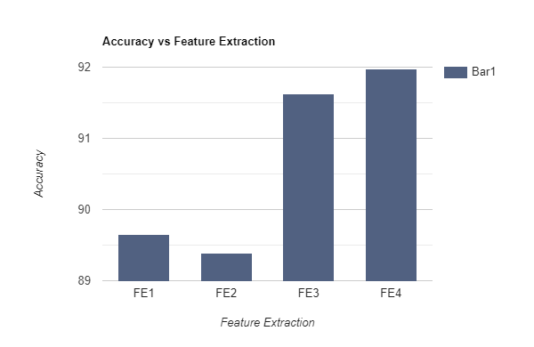
Finalized Feature Extraction
Notes:
jhh

Slide 31
Finalized Feature Extraction
Naive Bayes Classifier accuracy for this feature extraction 1 is 0.8964 or 89.65%
Naive Bayes Classifier accuracy for this feature extraction 2 is 0.8939 or 89.39%
Naive Bayes Classifier accuracy for this feature extraction 3 is 0.9162 or 91.62%
Naive Bayes Classifier accuracy for this feature extraction 4 is 0.9197 or 91.97%
Maximum Accuracy :0.9197, is of feature extraction 4.
Hence, the Finalized Feature Extraction is feature extraction 4.
Notes:
jhh

Slide 32
Classification Models
3.3
Step 3

Slide 33
Classification
Classification can be performed on structured or unstructured data.
Classification is a technique where we categorize data into a given number of classes.
The main goal of a classification problem is to identify the category/class under which new data will fall.
Classification model used in this project are:
-> Multinomial Naive Bayes
->Logistic Regression
->Stochastic Gradient Descent
Notes:
jhh

Slide 34
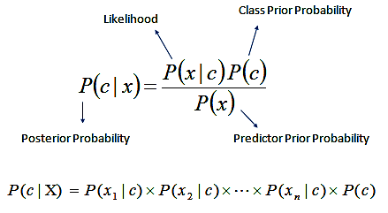
Multinomial NB
Naive Bayes is built on Bayes’ theorem, where the adjective Naïve says that features in the dataset are mutually independent. The occurrence of one feature does not affect the probability of occurrence of the other feature. For small sample sizes, Naïve Bayes can outperform the most powerful alternatives. Being relatively robust, easy to implement, fast, and accurate, it is used in many different fields.
Accuracy of this Classifier:0.9066
Notes:
jhh

Slide 35
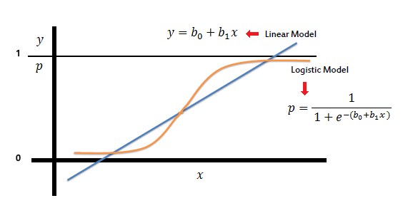
Logistic Regression
Logistic regression is a process of modeling the probability of a discrete outcome given an input variable. The most common logistic regression models a binary outcome; something that can take two values such as true/false, yes/no, and so on. Multinomial logistic regression can model scenarios where there are more than two possible discrete outcomes. Logistic regression is a useful analysis method for classification problems, where you are trying to determine if a new sample fits best into a category
Accuracy of this Classifier:0.9151
Notes:
jhh

Slide 36
Stochastic Gradient Descent
Stochastic gradient descent is an optimization algorithm often used in machine learning applications to find the model parameters that correspond to the best fit between predicted and actual outputs. It’s an inexact but powerful technique.
Accuracy of this Classifier:0.9188
Notes:
jhh

Slide 37
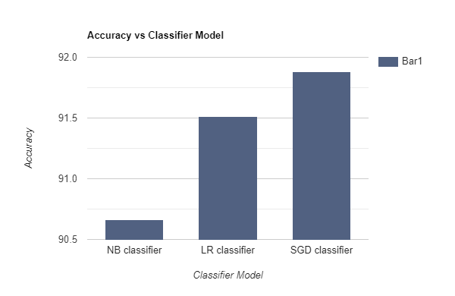
Multinomial NB vs Logistic Regression vs
Stochastic Gradient Descent
Notes:
jhh

Slide 38
Multinomial NB vs Logistic Regression vs
Stochastic Gradient Descent
Based on the accuracy of these three classification models we select the best model for the prediction model.
Multinomial NB :0.9066
Logistic Regression:0.9151
Stochastic Gradient Descent:0.9188
As maximum accuracy is achieved by SGD Classifier we use it as the model for prediction.
Notes:
jhh

Slide 39
Prediction Model
3.3
Step 3

Slide 40
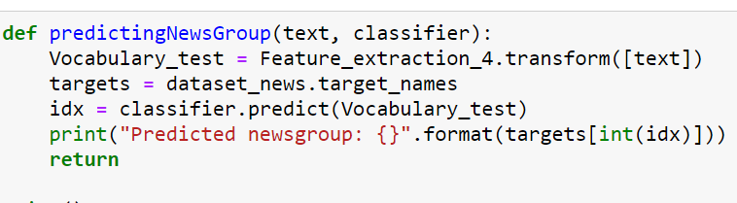
predictingNewsGroup()
Notes:
jhh

Slide 41
predictingNewsGroup()
From the above slides we inferred that the best model for prediction is
SGD classifier so we use it in our prediction model.
We use this function to predict from which file the input exists and prints the predicted filename.
Notes:
jhh

Slide 42
THANKS!

Slide 43
Sources
Machine learning workflow:www.gatevidyalay.com/tag/machine-learning-process-diagram/
Graphs:https://www.rapidtables.com/tools/bar-graph.html
Useful information:
https://scikit-learn.org/stable/index.html
Prutor AI ML notes(provided by trainer)

